Slide 1
Influenza (Flu) Vaccine
Julienne Saladino

Slide 2
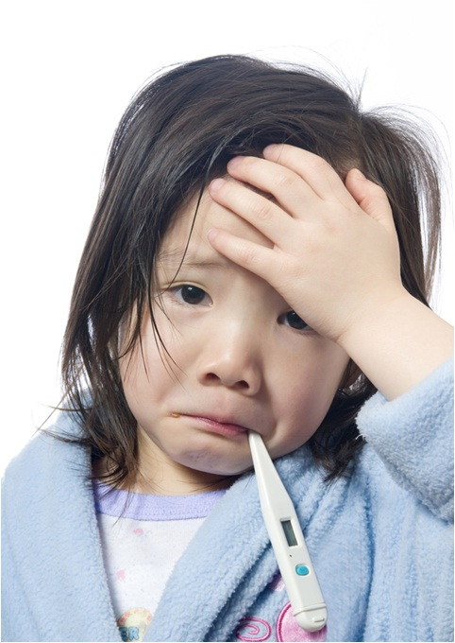
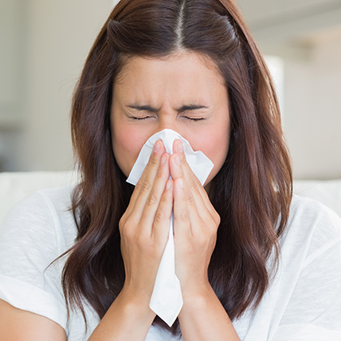
Influenza
What is influenza
  Influenza, which is commonly known as the “flu," is an infectious disease caused by the Influenza virus.
Common Symptoms
High Fever | Runny Nose | Sore Throat
Body Aches | Headache | Coughing
Fatigue (Feeling Tired)

Slide 3
Do I have to worry about the flu?
“I get sick all the time and it usually goes away on its own anyway.”

Slide 4
YES!
Influenza is something that you should definitely worry about!
Did you know that 3,000 – 55,000 people die from the flu every year?

Slide 5
Severity of the Influenza Virus
Influenza affects 5-20% of the U.S population every year
Over 200,000 people are hospitalized due to flu-related complication every year
Influenza is a highly contagious viral infection that affects the nose, throat, and lungs

Slide 6
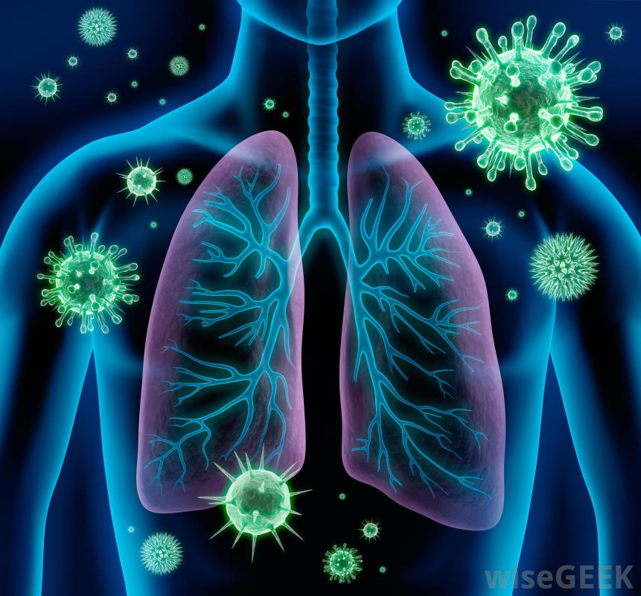
Severity of the Influenza Virus
While most people with the flu are able to get well within 2 weeks, others can experience further serious complications as a result of the flu!
Complications include (but are not limited to) …
  Pneumonia (inflammation of the lungs)
  Encephalitis (inflammation of the brain)
  Myositis (inflammation of muscle tissue)
  Myocarditis (inflammation of the heart muscle)

Slide 7
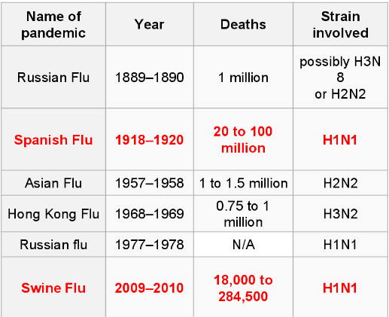
History of the Flu

Slide 8
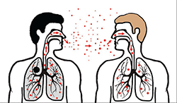
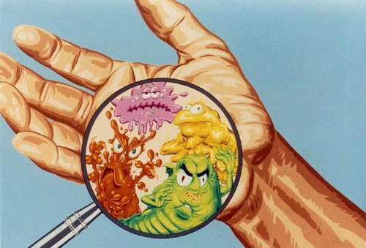
Transmission
How does someone get the flu?
Direct contact with a sick person
Touching contaminated objects
Breathing in small droplets of the virus that is in the air (aerosols) after someone coughs or sneezes

Slide 9



Prevention
How can I protect myself and others from getting the flu?
  Getting vaccinated every year! *
  Covering your mouth when you cough
  Covering your nose and mouth when you sneeze
  Washing your hands regularly

Slide 10
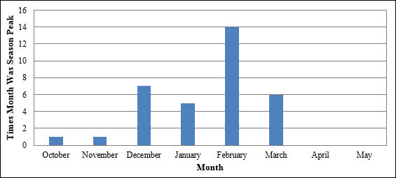
Flu season starts in the fall and can last through the month of May
(CDC)

Slide 11
How effective is the Flu vaccine?
Does the flu vaccine work right away?
No. It takes about 2 weeks after getting vaccinated before your body can develop the immunity to protect itself against the influenza virus.
Can I still get the flu even though I got vaccinated?
It’s possible. There are many different strains of the flu virus going around in the community every year. If the virus in the vaccine and the virus that you’re exposed to are not closely matched, then you can still get the flu.
However, the flu vaccine can still prevent flu-related complications and make your illness less severe.

Slide 12
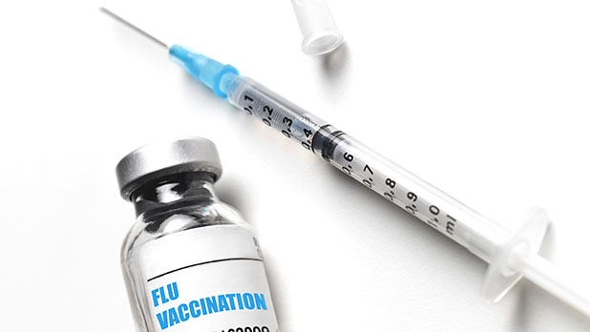

How effective is the Flu vaccine?
Why should I get vaccinated?
Getting vaccinated will protect yourself and others from getting flu.
Will getting the vaccine make me sick?
No. The flu vaccine DOES NOT cause flu illness.

Slide 13
References
Centers for Disease Control and Prevention, National Center for Immunization and Respiratory Diseases.
(2016, July 26). The flu season. Retrieved from https://www.cdc.gov/flu/about/season/flu-season.htm.
Centers for Disease Control and Prevention, National Center for Immunization and Respiratory Diseases.
(2016, December 9). The benefits of flu vaccination 2015-2016 infographic.
Retrieved from https://www.cdc.gov/flu/spotlights/flu-vaccine-protected-infographic.htm.
Centers for Disease Control and Prevention, National Foundation for Infectious Diseases (n.d.). Influenza (flu).
Retrieved from http://www.nfid.org/idinfo/influenza.

