Slide 1
HPV Vaccine human papillomavirus
Meldrick Ravida

Slide 2
What is HPV?
HPV stands for human papillomavirus
There are many different types of HPV
Sexually transmitted infection
Most common STI in the United States
Nearly all men and women contract it at one point in their life

Slide 3
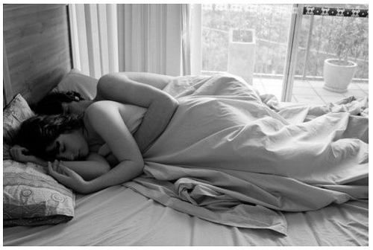
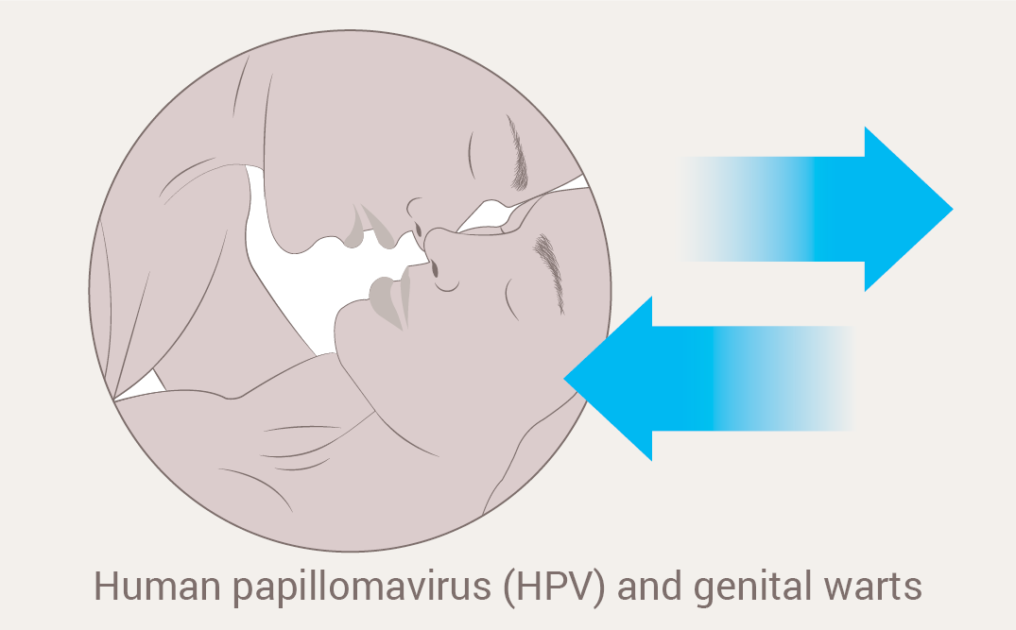
Transmission
Intimate skin-to-skin contact
Having vaginal, anal, or oral sex with someone who has the virus

Slide 4
Signs & Symptoms
The most common are small, hard sores called warts,
  but not everyone who has HPV gets them.
Can lead to cancer
  In males & females: mouth/throat, anus/rectum
  In males: penile
  In females: cervical, vaginal, and vulvar

Slide 5
Treatment
There's no cure for the virus
The virus can go away on its own without any signs or symptoms
Treatment focuses on the symptoms HPV causes

Slide 6

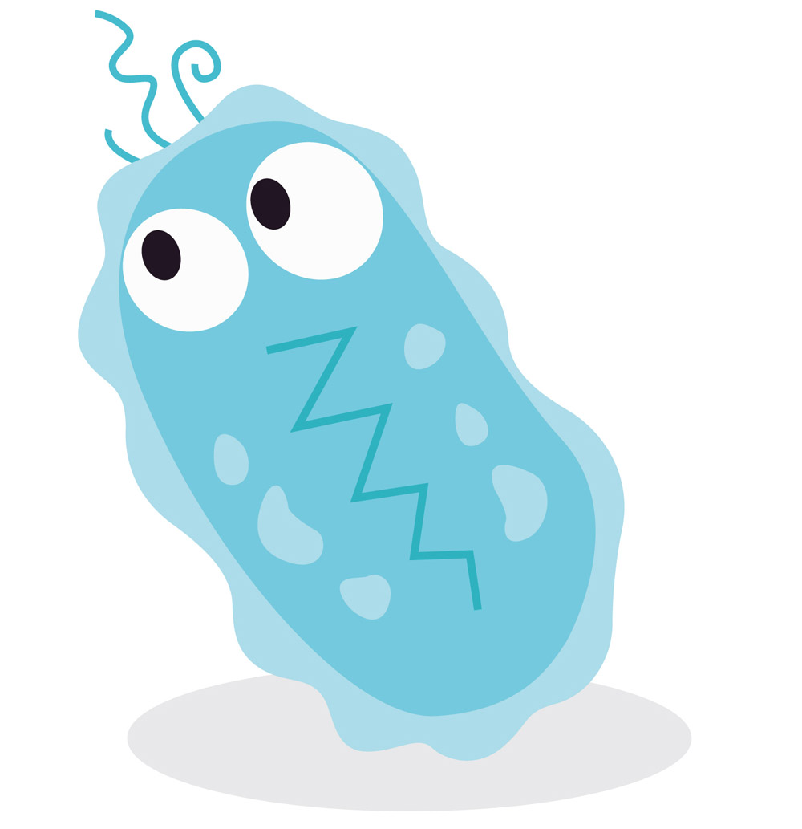
The Vaccine
The HPV vaccine contains strains in virus-like particles (VLPs) which make it safe and effective in preventing HPV.

Slide 7
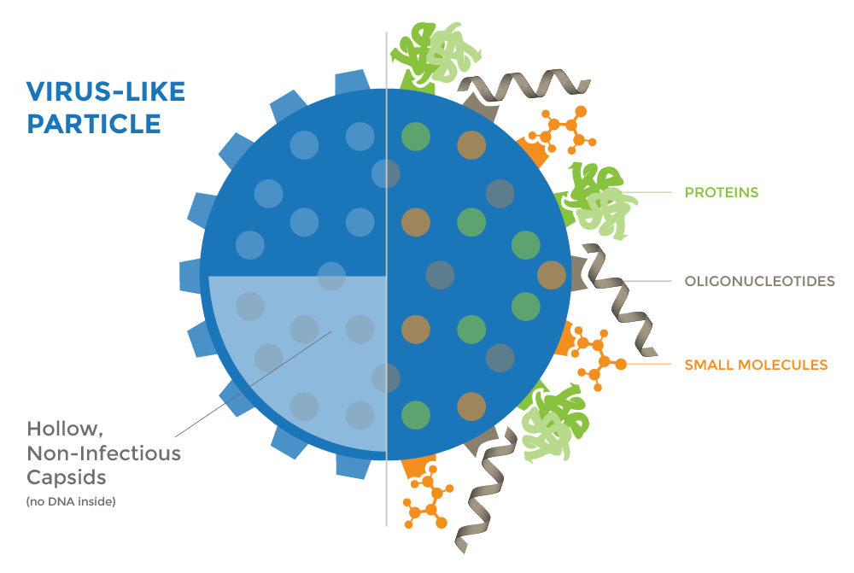
Virus-like Particles (VLP)
Virus-like particles are safe
They do not contain the virus
They look like the virus
  Tricks the immune system into responding, making antibodies

Slide 8
Vaccine Schedule
AGE | DOSES | SCHEDULE
9-14 years | 2 DOSES | 1st shot: today 2nd shot: 6-12 months later
15-26 years | 3 DOSES | 1st shot: today 2nd shot: 1-2 months later 3rd shot: 6 months later

Slide 9
HPV vaccine is
cancer prevention

Slide 10
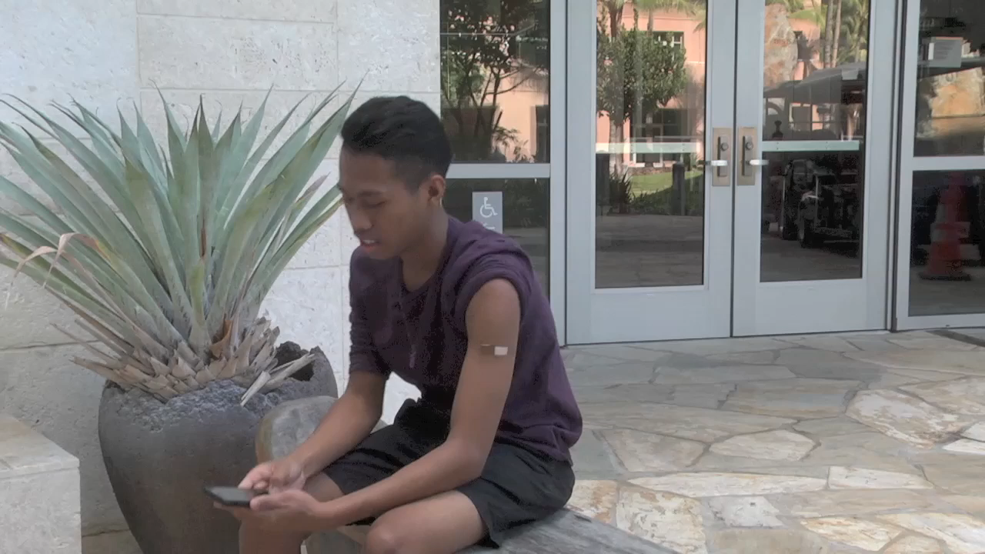

Slide 11
References
Centers for Disease Control and Prevention, Division of STD Prevention, National Center
for HIV/AIDS, Viral Hepatitis, STD, and TB Prevention (2016, November 4). Genital HPV
Infection - Fact Sheet. Retrieved from https://www.cdc.gov/std/hpv/stdfact-
hpv.htm
Centers for Disease Control and Prevention. (2016, December 20). Human papilloma
virus (HPV). Retrieved from https://www.cdc.gov/hpv/parents/whatishpv.html

