Slide 1
Tdap Vaccine tetanus, diphtheria, and pertussis
Jaclyn Topinio

Slide 2
What is the Tdap vaccine?
a combined vaccine that protects children and adults against three diseases:
Diphtheria, Tetanus, and Pertussis

Slide 3
Tdap is a booster vaccine
 | Birth – 1 Mos | 2 Mos | 4 Mos | 6 Mos | 9 - 12 Mos | 15 -18 Mos | 19 Mos - 3 Yr | 4 – 6 Yr | 7 – 10 Yr | 11 – 12 Yr | 13 – 18 Yr
DTaP |  | 1st dose | 2nd dose | 3rd dose | Catch up | 4th dose | Catch up | 5th dose
Tdap |  |  |  |  |  |  |  |  | Catch up | Tdap | Catch up
Booster Vaccine

Slide 4
Tdap – Booster Vaccine
The protection you received from this shot for tetanus, diphtheria, and pertussis given to you as a baby wears off by the time you are 11 to 12 years old
Allows a person to maintain their immunity against these diseases

Slide 5
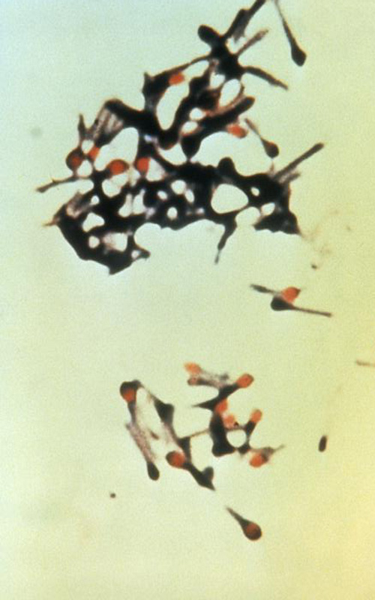

Tetanus (Lockjaw)
Cause by poison made from bacteria (Clostridium tetani)
Found in soil, dust, and manure
Transmission
  Enters the body through breaks in the skin

Slide 6

Tetanus (Lockjaw)
Signs & Symptoms
  Painful muscle cramps and stiffness in the jaw muscle and in other parts of the body
    May cause breathing problems and paralysis
1-2 out of 10 people who get this disease dies

Slide 7
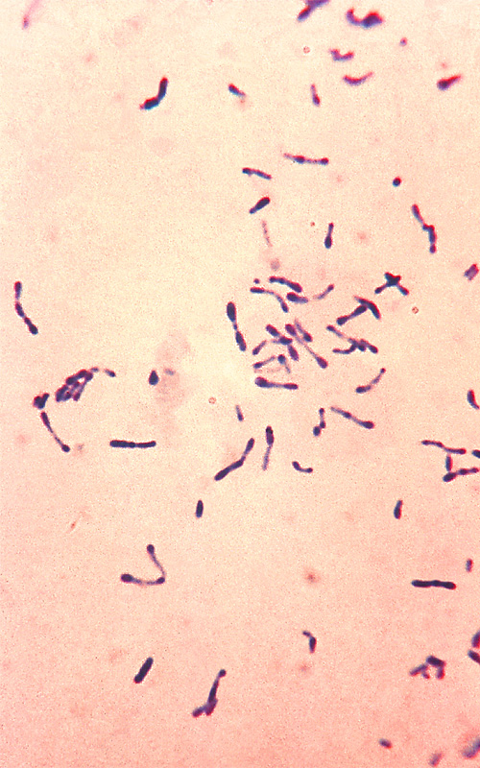
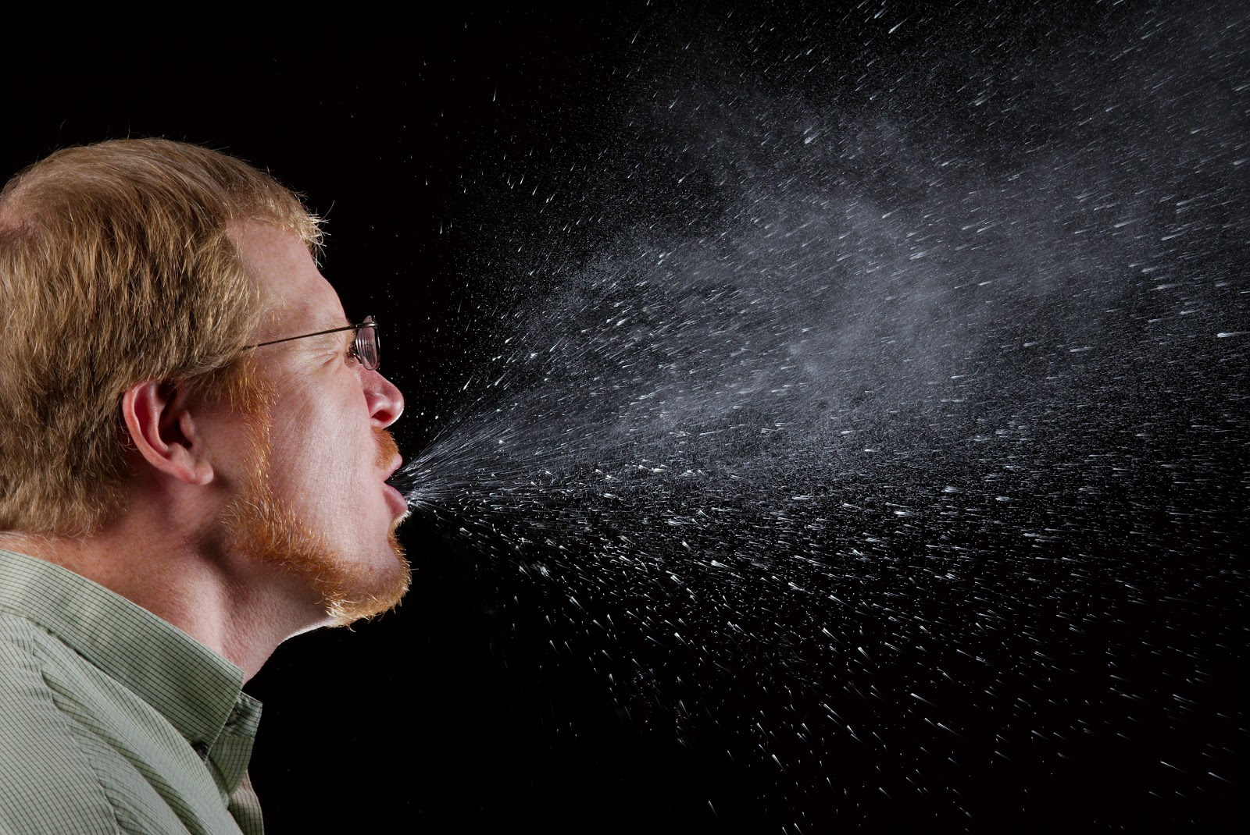
Diphtheria
Caused by bacteria (Corynebacterium diphtheriae)
Transmission
  From person to person through droplets in the air
    Sneezing
    Coughing

Slide 8
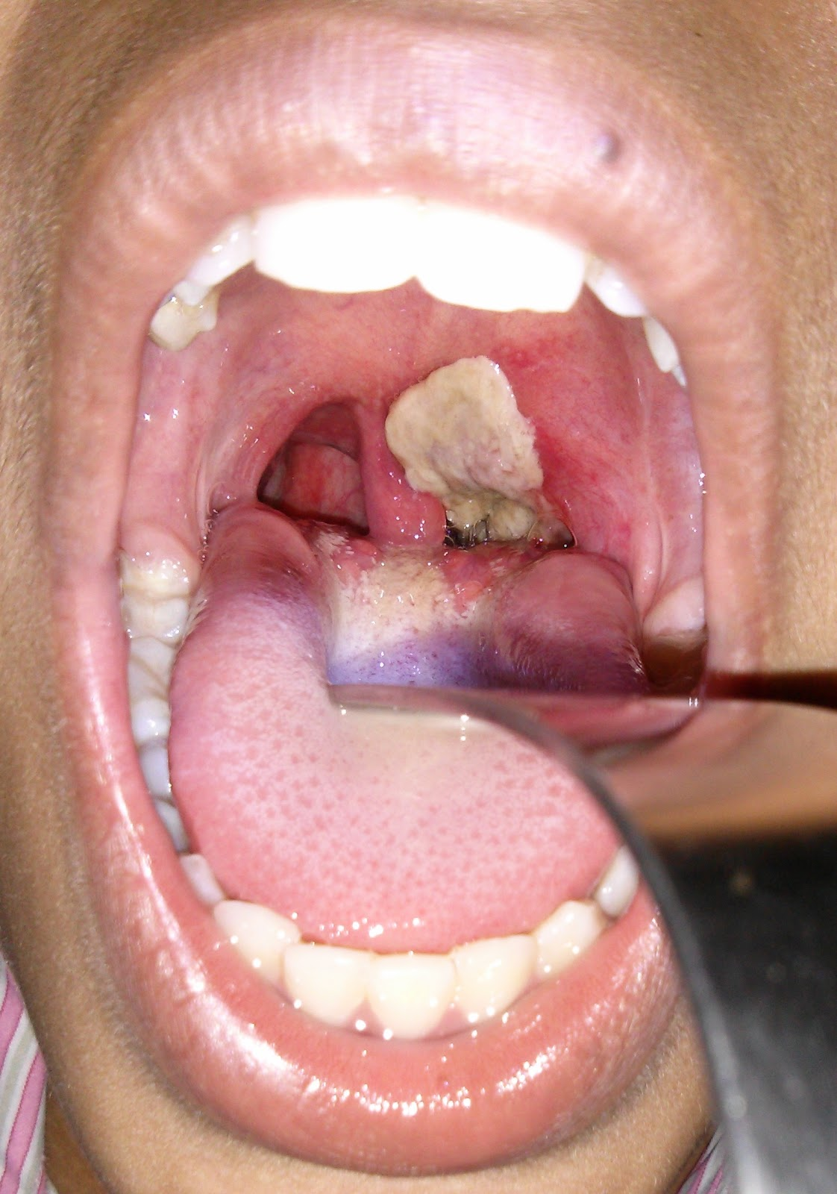
Diphtheria
Signs & Symptoms
  Causes a thick coating to form in the back of the throat
    Can lead to breathing problems, heart failure, and paralysis
1 out of 10 people who get diphtheria die from it

Slide 9
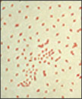
Pertussis (Whooping Cough)
Caused by the bacteria (Bordetella pertussis)
Transmission
  From person to person
    Sneezing
    Coughing

Slide 10

Pertussis (Whooping Cough)
Signs & Symptoms
  Coughs that lasts for a long period of time
    Causes difficulty breathing, vomiting, disturbed sleep
Most deadly to babies

Slide 11
References
Centers for Disease Control and Prevention (2015, October 27). Diphtheria, Tetanus, and Pertussis Vaccine
Safety. Retrieved from https://www.cdc.gov/vaccinesafety/vaccines/Dtap-tdap-vaccine.html
Centers for Disease Control and Prevention (2017, January 10). Tetanus. Retrieved from
https://www.cdc.gov/tetanus/index.html
Centers for Disease Control and Prevention (2016, January 15). Diphtheria. Retrieved from
https://www.cdc.gov/diphtheria/index.html
Centers for Disease Control and Prevention (2016, January 26). Pertussis. Retrieved from
https://www.cdc.gov/pertussis/index.html
Centers for Disease Control and Prevention (2017, February 6). Immunization Schedules. Retrieved from
https://www.cdc.gov/vaccines/schedules/hcp/imz/child-adolescent.html
National Center for Immunization and Respiratory Diseases (2016, October 18). Tdap (Tetanus, Diphtheria,
Pertussis) VIS. Retrieved from https://www.cdc.gov/vaccines/hcp/vis/vis-statements/tdap.html

